Slide 1
HCI Task: Redesigning the Elementary Student Portal
Applying core Human-Computer Interaction (HCI) principles to analyze and improve the User Experience (UX) of a crucial student resource.
Objective: To analyze and improve the User Experience (UX) of a website by applying core Human-Computer Interaction principles.

Slide 2
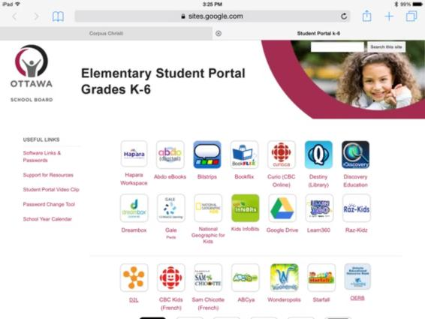
INITIAL ANALYSIS
The "Before" Design: Identifying Usability Gaps

Slide 3
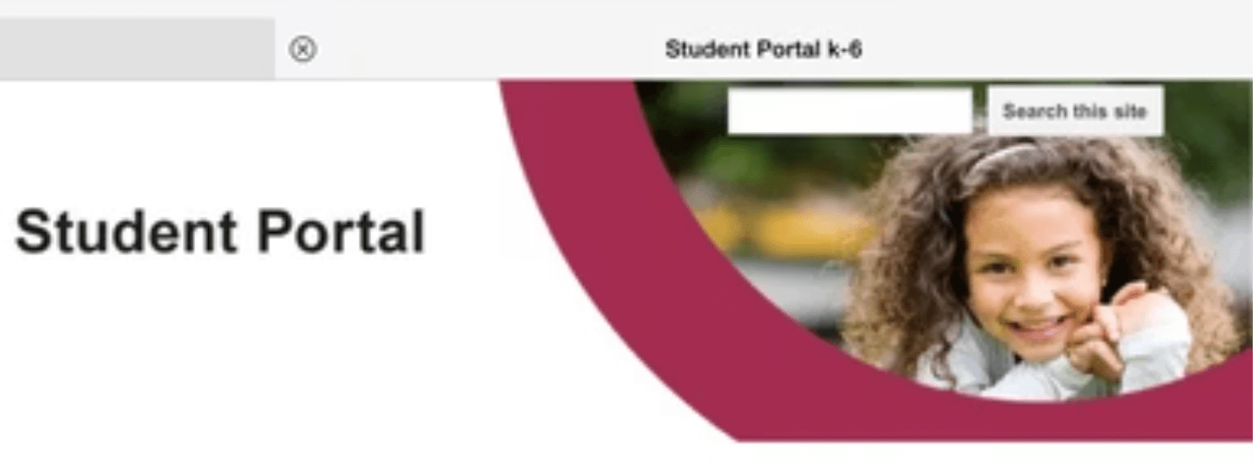
INITIAL ANALYSIS
The "Before" Design: Identifying Usability Gaps
Analysis of the original design (below) revealed several critical issues that caused lack of usability for young students.
Low Efficiency:
Key functions, like the "Search this site," are small and hidden, resulting in slow and inefficient navigation.

Slide 4
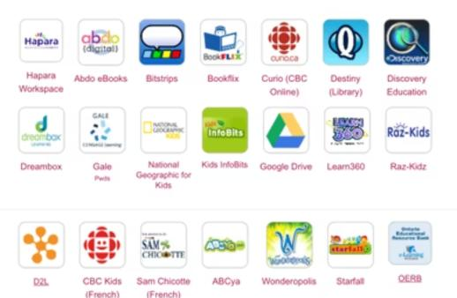
INITIAL ANALYSIS
The "Before" Design: Identifying Usability Gaps
Analysis of the original design (below) revealed several critical issues that caused lack of usability for young students.
Poor Visibility & Consistency:
It's hard to see what's most important ; random icon shapes and sizes confuse the user.
High Cognitive Load:
The chaotic layout forces visual scanning and processing of over 20 unique items, mentally exhausting young students.

Slide 5
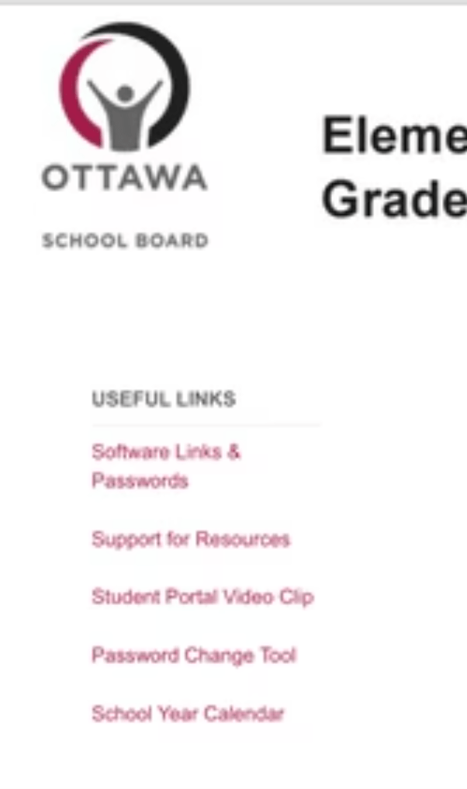
INITIAL ANALYSIS
The "Before" Design: Identifying Usability Gaps
Analysis of the original design (below) revealed several critical issues that caused lack of usability for young students.
Poor Emotional Design
the messy, crowded page looks bad and old , making students feel frustrated

Slide 6
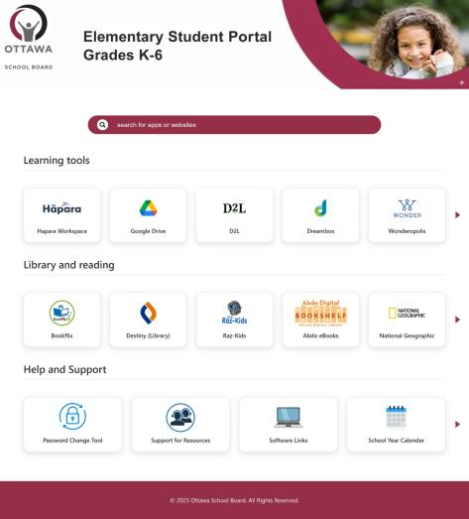
DESIGN SOLUTION
The "After" Design: Structure and Clarity

Slide 7
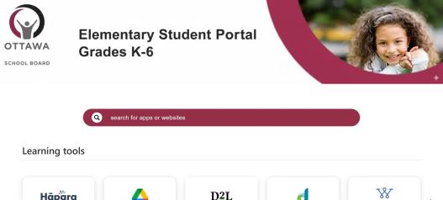
DESIGN SOLUTION
The "After" Design: Structure and Clarity
The redesign transformed the chaotic page into a clean, modern, and structured interface centered around user needs.
The "After" Design: Organized for Clarity
Search bar:
The large, centered search bar makes it fast and easy to find specific tools and content.

Slide 8
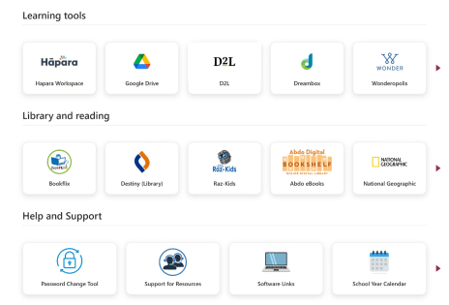
DESIGN SOLUTION
The "After" Design: Structure and Clarity
The redesign transformed the chaotic page into a clean, modern, and structured interface centered around user needs.
The "After" Design: Organized for Clarity
Card design
A uniform "card" design is used for all links, ensuring visual consistency across the board.
Content is organized into logical, user-centered categories for quick browsing.

Slide 9
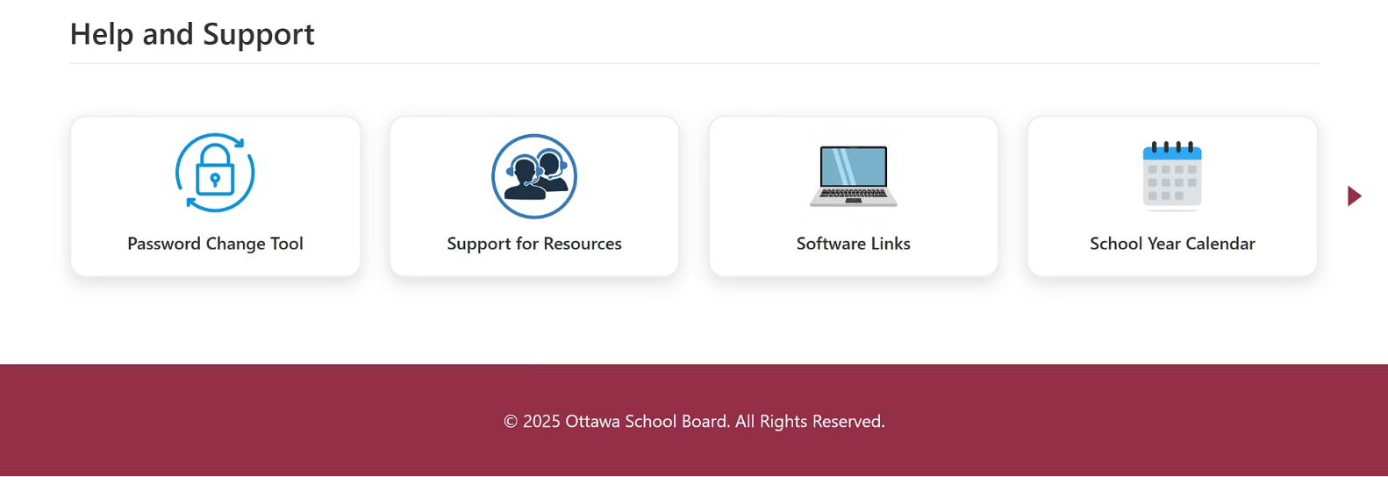
DESIGN SOLUTION
The "After" Design: Structure and Clarity
The redesign transformed the chaotic page into a clean, modern, and structured interface centered around user needs.
High Efficiency
The "After" Design: Organized for Clarity
(replacing the useful links section)
Content is organized into logical, user-centered categories for quick browsing.
Spacing
Strategic use of whitespace and clear typography improves readability and reduces visual noise.

Slide 10
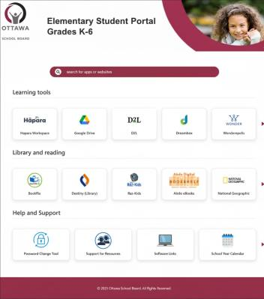

Visualizing the Transformation
A side-by-side comparison highlights the improvement in organization, clarity, and overall The visual style.
Before: Chaotic and Inconsistent
After: Organized and Intuitive
Over 20 icons with no visual grouping or clear hierarchy.
Categorized content, uniform cards, and a clear path to key features.

Slide 11
SUMMARY OF IMPACT
A More Usable and Effective Portal
The redesign successfully transformed the student portal from a frustrating, inefficient page into one that meets core usability goals:
Effective
Easy to Learn
Users can successfully find and launch the tools they need to complete their educational tasks.
The consistent structure, uniform elements, and logical flow make the portal predictable for new and returning students.
Efficient
Users can find tools quickly, utilizing either the centralized search or the newly organized categories.

Slide 12

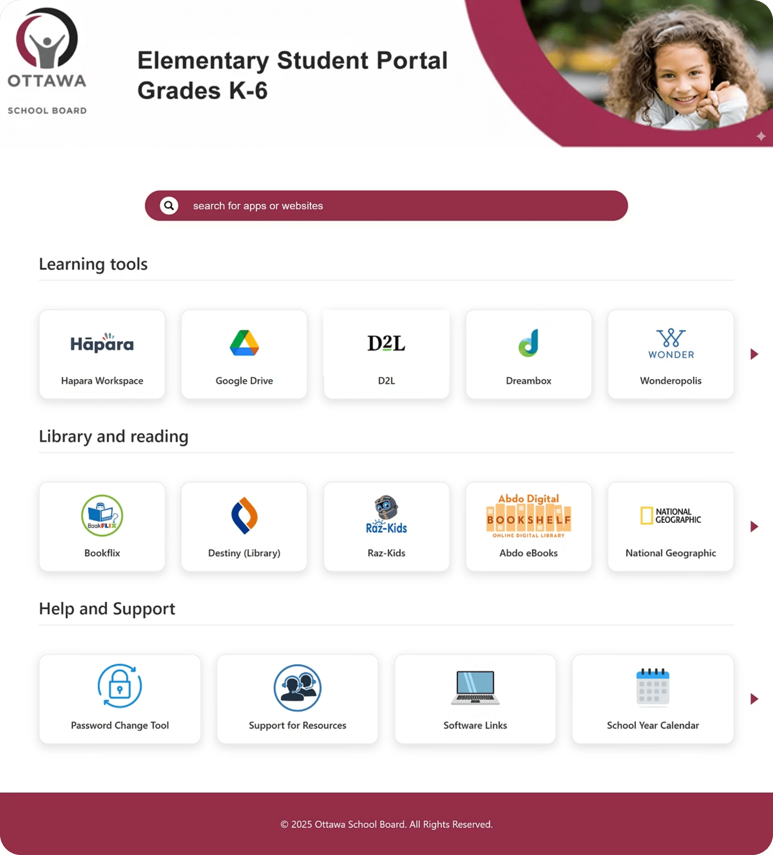

Key Takeaways: HCI Principles in Practice
By focusing on fundamental design principles, we achieved a significant improvement in the student experience.
Consistency
Uniform card design and repeatable interaction patterns.
Visibility
placing the most powerful feature: the search bar.
Affordance
Designing elements that clearly look and behave like buttons or links.
Categorization
Applying User-Centered Design to create logical information architecture.
The result is a significantly better and more usable digital experience for every elementary school student.

Slide 13
Extending the design: Better Support for Everyone
Making it easy to get help on any device.
We expanded the design to include critical support issues, ensuring students can get help quickly whether they are on a laptop or a tablet.

Slide 14
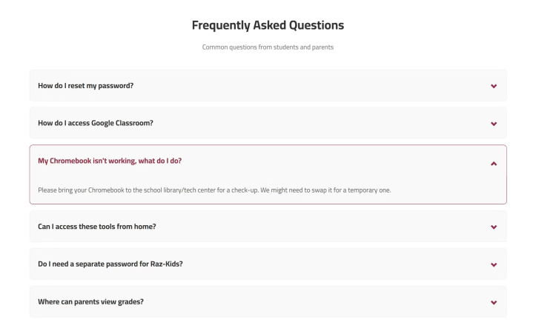
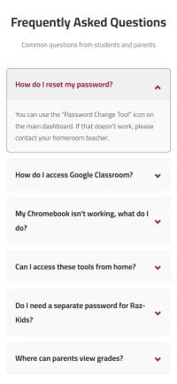
FAQ design (According)
A side-by-side comparison highlights the organization, clarity, and overall The visual style for the frequently asked questions (faq) .

Slide 15
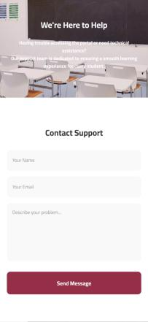
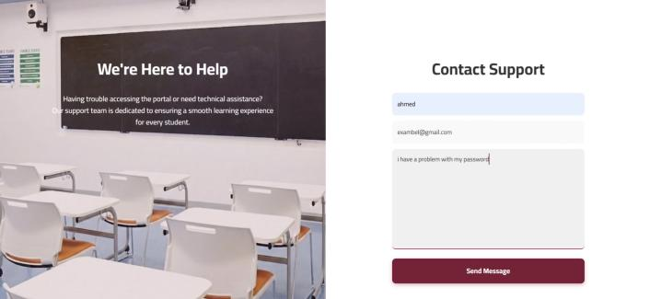
Contact Support: Visibility & Feedback
HCI Principles: Feedback, Visibility of System Status.
if the students or the parents did not get the information they needed they can contact support

Slide 16
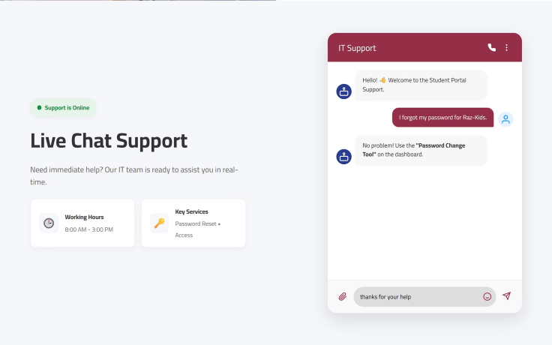
Live Chat: Desktop View
Side-by-Side View
On large screens, we show the chat and the help information next to each other.
Status Indicator
A green "Online" light shows students that support is ready to help instantly.
Familiar Design:
The chat looks like popular apps (like WhatsApp), so students already know how to use it.

Slide 17
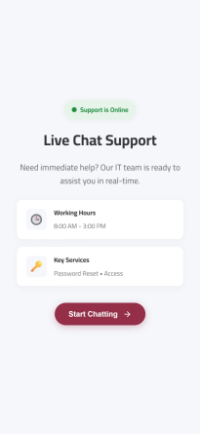
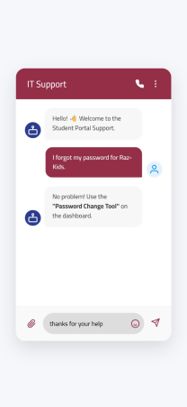
Live Chat: Mobile Flow
Smart Layout:
On mobile, we separated the "Info" from the "Chat" to avoid crowding the small screen.
Step-by-Step:
First, the student sees the working hours and a "Start" button.
Then, the screen smoothly scrolls down to the chat area.
Better Experience:
This makes the mobile experience feel like a real app, not just a squeezed website

Slide 18
SUMMARY OF NEW FEATURES
A Complete Support System
We extended the simple and clean design to all support pages.
FAQ
Contact Support
Organized: We used expandable lists to keep the page short and tidy. Students can find answers quickly without getting lost.
Simple:We removed all distractions. The form has large, clear inputs that are easy to use on touch screens
Live Chat
Smart Layout: The design changes based on the device. On desktop, it shows everything at once. On mobile, it splits into two steps to fit the small screen perfectly.

Slide 19
Created by :
احمد محمد السيد محمد البرعي
محمود الحسين محمد ماضي

